Slide 1
Managing a Security Container
Lockheed Martin Missiles and Fire Control
FISWG
April 12, 2017

Slide 2
What we will cover…
Outside
Inside
Security Measures

Slide 3
Outside of the Safe

Slide 4
Outside of the Safe
5-301. GSA Storage Equipment. GSA establishes and publishes uniform standards, specifications, and supply
schedules for units and key-operated and combination padlocks suitable for the storage and protection of
classified information
Emergency Contact Information Record listing the Primary Custodian

Slide 5
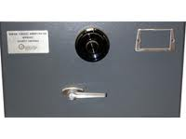
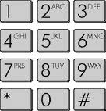
Outside of the Safe
DO NOT indicate on the outside of the safe the level of classified material stored within
DO NOT cover the silver GSA certified seal
DO display the Open/Closed sign (available from Security) on the outside of the container and use it appropriately

Slide 6
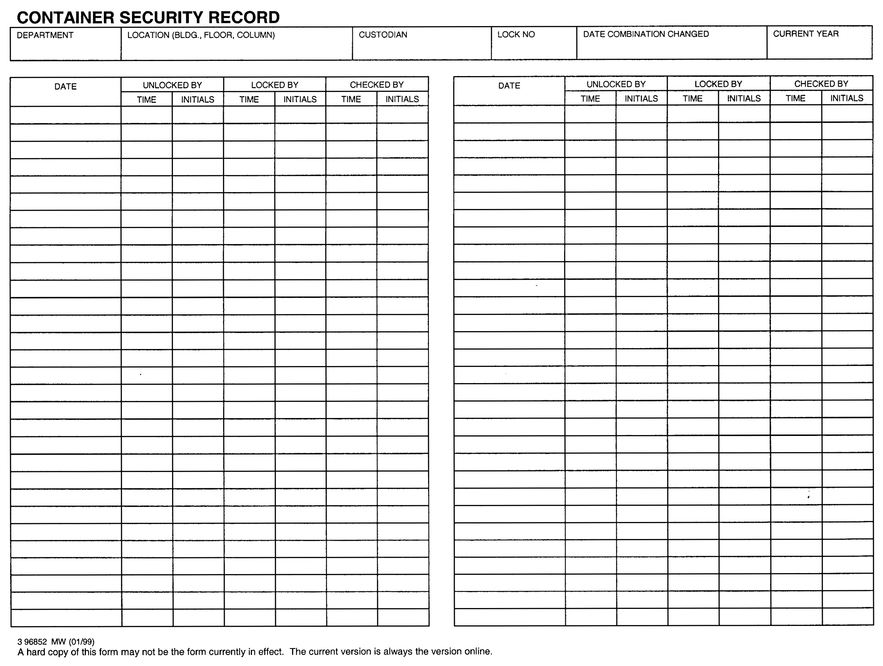
Outside of the Safe
Container Security Record Log Sheet – SF702

Slide 7
Inside of the Safe

Slide 8
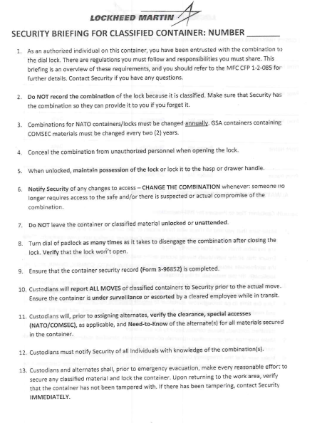
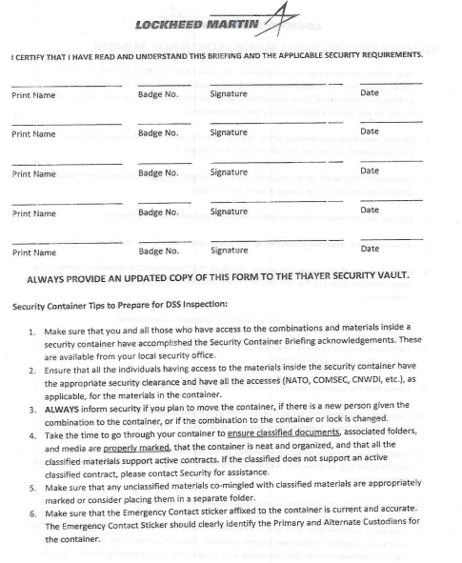
Inside of the Safe
Security Briefing

Slide 9
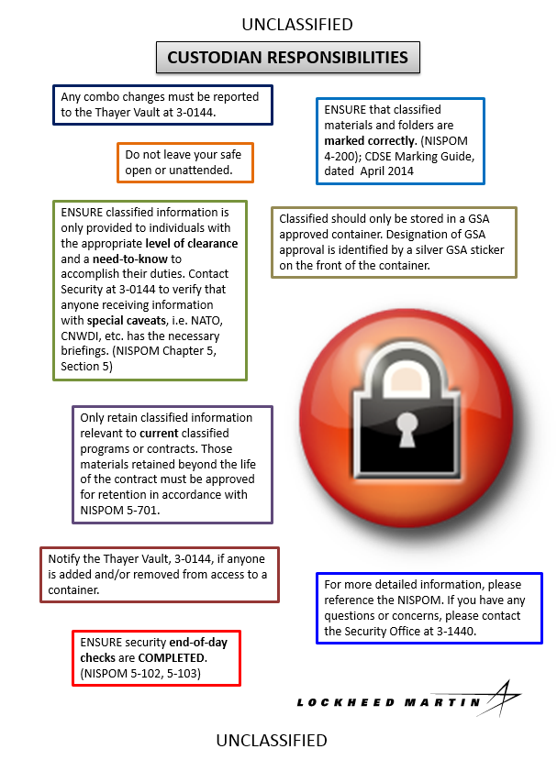
Inside of the Safe
CDSE Marking Guide
Custodian’s Responsibilities Sheet

Slide 10
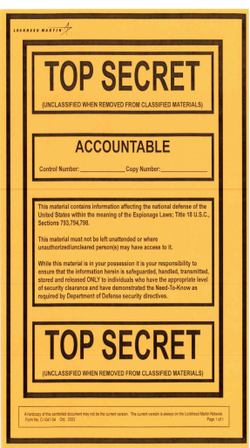
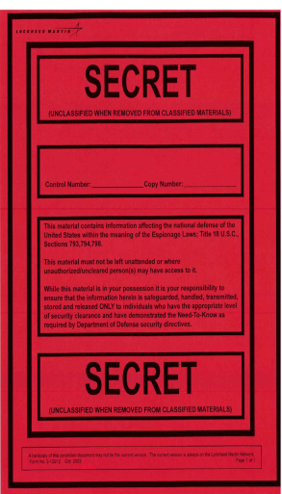
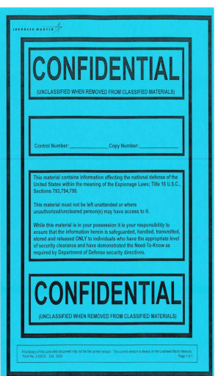
Inside of the Safe
Store Classified and Unclassified material
Coversheets
Separate from Classified material and label “Unclassified”

Slide 11
Inside of the Safe
NATO, Foreign Government Information (FGI), COMSEC etc. MUST be separated
Separate by divider or place in its own drawer
FGI information MUST be marked in English with country of origin
Only maintain the minimum classified material required for the project

Slide 12
Information Management
NISPOM 5-200
Contractors shall establish an information management system to protect and control the classified information in their possession…
The information management system employed by the contractor shall be capable of facilitating such retrieval and disposition in a reasonable period of time

Slide 13
Information Management
Only specific with TOP SECRET; however…
An inventory shall be conducted annually…
Transmittal shall be covered by a continuous receipt system both within and outside the facility…
Each item shall be numbered in series. The copy number shall be placed on documents and on all associated transaction documents…
SIMS, Excel, etc…
Document No.
Status
Class
Document Title
Contract Number
2016-04939-002
IN
SN
Technology Trends (U)
Contract Number-04-X-0001
2016-04939-003
OUT
SN
Widget Works (U)
Contract Number-04-X-0001
2016-04939-004
IN
S
Proposal Outline (U)
Contract Number-04-X-0001
2016-04939-005
IN
SN
Simulator Results (U)
Contract Number-04-X-0001
2016-04939-006
OUT
SN
Strategic Plan (U)
Contract Number-04-X-0001
2016-04939-007
IN
S
Sensors (U)
Contract Number-04-X-0001
2016-04939-008
IN
S
Organizational Guide (U)
Contract Number-04-X-0001
2016-04939-009
IN
SN
Financials (U)
Contract Number-04-X-0001

Slide 14
Security Measures

Slide 15
Security Measures
NEVER leave an open safe unattended
Ensure all individuals accessing the safe:
Are cleared
Have a need to know
Have all required briefings (NATO, COMSEC, etc.)
Combinations are classified to the level of the material stored within and must be committed to memory
Combination Changes (5-309)
The initial use of an approved container or lock for the protection of classified material
The termination of employment of any person having knowledge of the combination, or when the clearance granted to any such person has been withdrawn, suspended, or revoked
The compromise or suspected compromise of a container or its combination, or discovery of a container left unlocked and unattended
At other times when considered necessary by the FSO or CSA

Slide 16
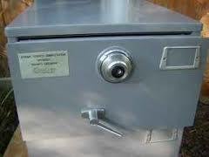
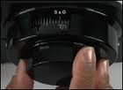
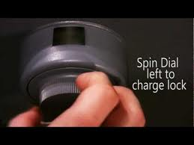
Security Measures
Ensure an end of the day check of each safe is conducted regardless if the safe has been opened or not
Physically pull on the lock or handle to verify the container is secured
Account for travel and vacations

Slide 17
Recap
Ensure the Emergency Contact Information is posted on the outside of the safe and is accurate
Ensure that ALL material in your safe is properly marked.
Ensure that all NATO/FGI documents are physically separate from other documents.
Ensure the safe is secured when left unattended
Ensure all individuals accessing the safe are cleared, have a need to know and have all required briefings
Ensure end of day checks are conducted
Ensure the combination is changed when required
Neatness counts! DSS like neat records!

